Slide 1
The definitions and functions of management
Learning Aim A

Slide 2
Management and leadership
Explain what the difference is between management and leadership, and give examples of managers & leaders for Lea Valley Academy.
Explain what is meant by management by objectives.
Management By Objectives (MBO) is an performance management approach in which a balance is sought between the objectives of employees and the objectives of an organisation.

Slide 3
Leadership
https://www.youtube.com/watch?v=avaFt-jcTso
https://www.youtube.com/watch?v=VrvsNt_tfSA
Based on the leaders above, what do you think about these two people as leaders?

Slide 4
Situational and Contingency leadership
A strategy that is related to a leaders or managers personality and behaviours. For example, just as you are likely to vary your personality or behaviour according to any given situation, so will a manager or leader.
Explain what is meant by situational and contingency leadership in a customer facing business such as Tesco.

Slide 5
Functional and action-centred
This theory defines action-centred management by three core responsibilities, which are:
Achieving the task
Managing the team or group, and
Managing individuals

Slide 6
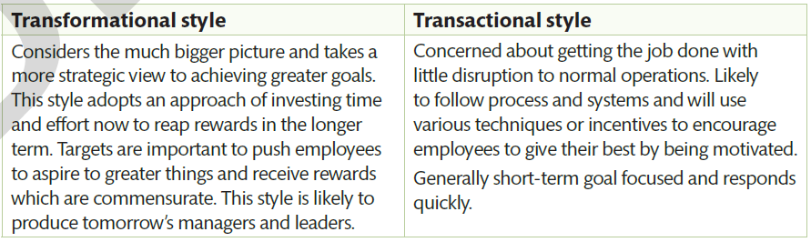
Transformational and Transactional
EXPLAIN THE DIFFERENCE. Which of these would apply to Lea Valley and why?

Slide 7
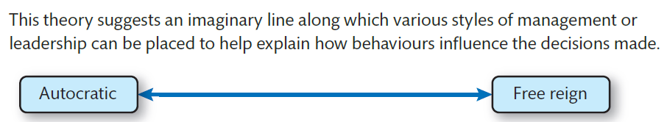
Leadership Continuum
For example, a manager or leader that lets their subordinates suggest or try out new approaches sits at the far right of the continuum.
Explain the advantages and the disadvantages of this type of leadership.

Slide 8
Write a short report (half a page) on what style of management and leadership you would prefer to work under? Explain why using examples.

Slide 9
Functions of management
Planning
Organising
Coordinating
Controlling
Monitoring
Delegating
Explain each of the 6 functions of management and say why these should be considered by a business such as Lea Valley Academy.

Slide 10
Functions of management
What skills do you think are crucial for managers? How effective are your skills in these areas?
Think about a manager’s day to day job in Aldi. What functions do you think they use the most?
3. Consider how the plans for the Olympic Stadium were monitored to ensure work was completed on time and within budget. Which function do you think is most important to a manager on a project of that scale?

Slide 11
What makes a good leader?
https://www.youtube.com/watch?v=gcEVvMPC088

Slide 12
Functions of Leadership
Inspiring
Energising
Influencing stakeholders
Envisioning
Determining the best path/route to achieve success
Explain each of the 5 functions of leadership and apply to Lea Valley Academy.

Slide 13
Business Culture
Explain what is meant by business culture by referring to the following:
Business vision, mission and values/ethos
Influence of business culture on management practices
Policies and procedures
Management styles
Structure of the workforce

Slide 14
About Turn!
1) Read the case study on page 69 & 70 and answer the questions.
2) Complete assessment practice 6.1

Slide 15
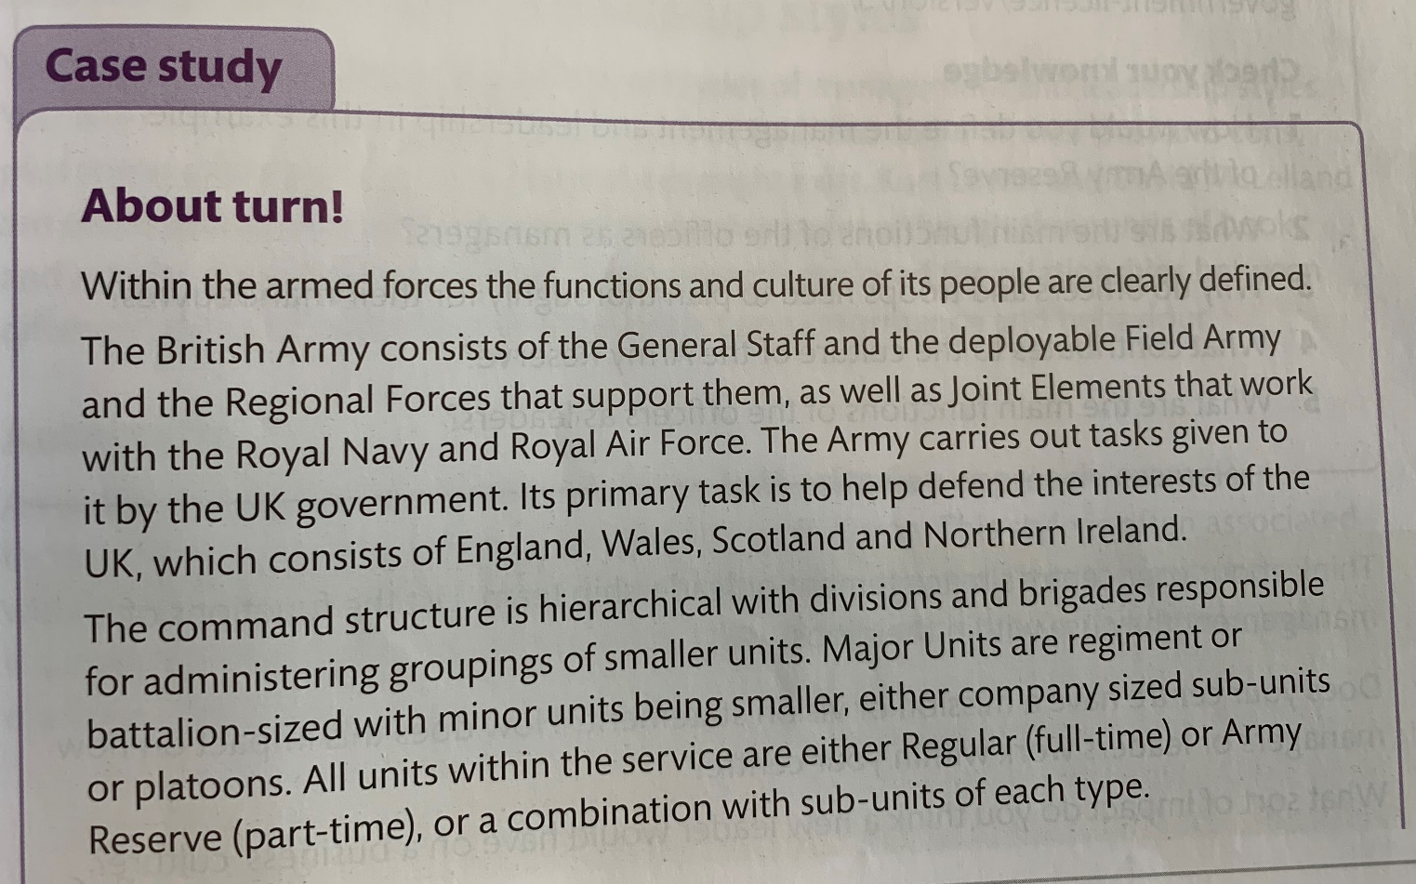
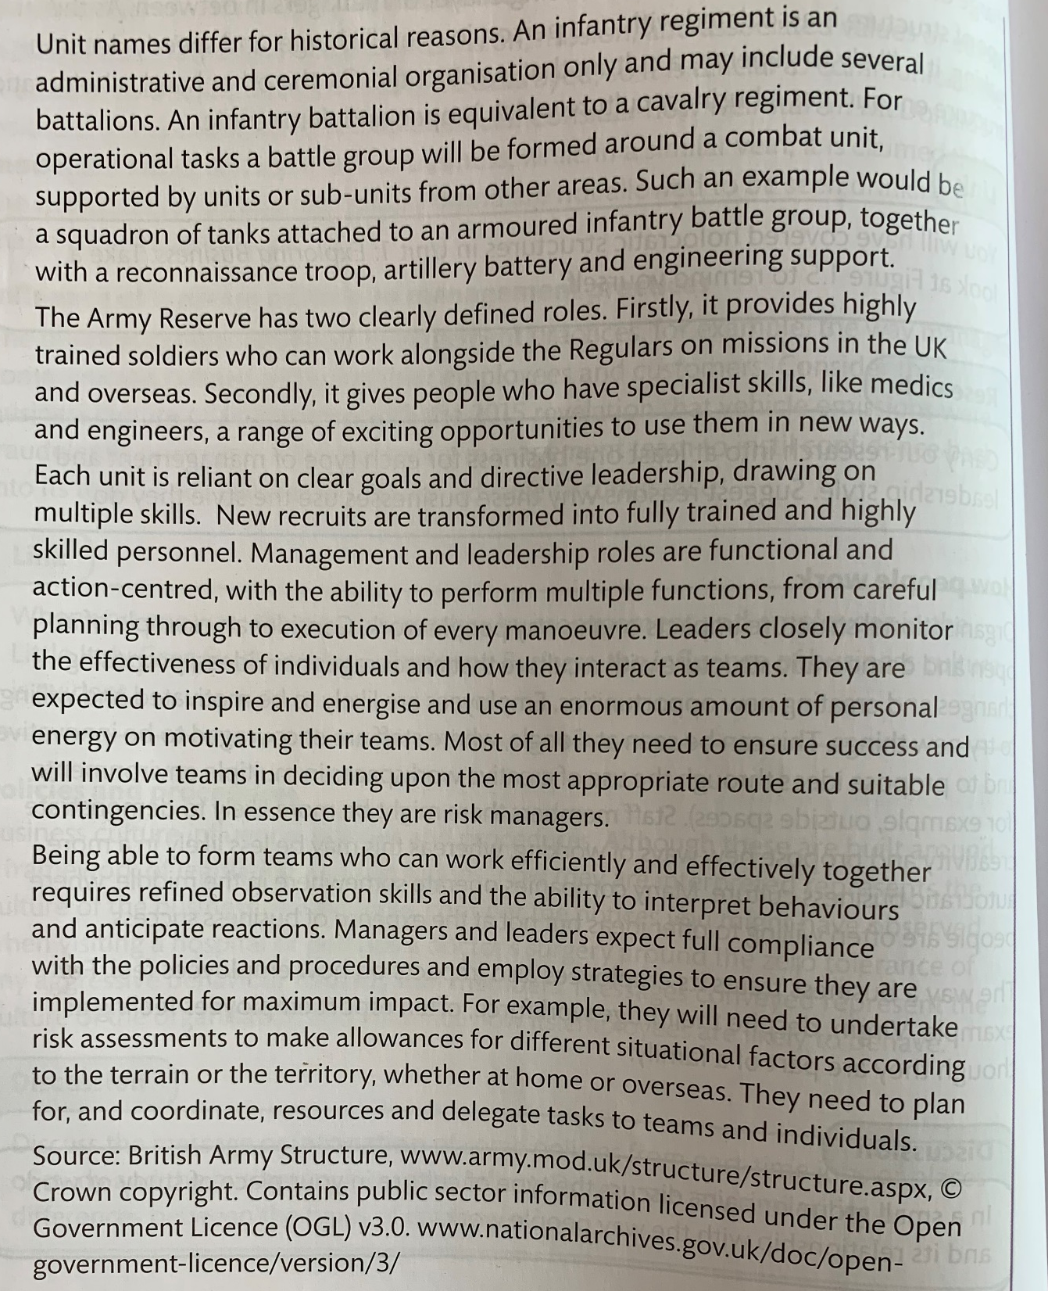
CHECK YOUR KNOWLEDGE
How would you define the management and leadership in this example?
What are the main functions of the officers as managers?
Why do officers and troops need to plan thoroughly for their manoeuvres?
What contributes to the culture of the Army Reserve?
What are the main functions of the officers as leaders?

Slide 16
